Slide 1
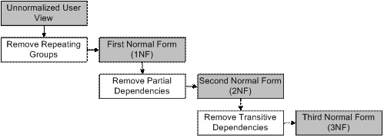
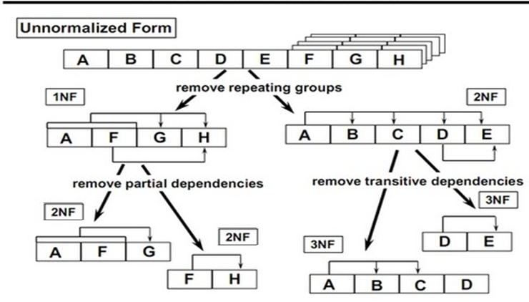
Normalization
Ibtisam Mogul

Slide 2
References
https://www.albany.edu/~goel/classes/fall2009/itm692/notes/normalization.ppt
ion.uwinnipeg.ca/~ychen2/access/8%20Normalization.ppt
www2.cs.uh.edu/~paris/6340/PowerPoint/Normalization.ppt

Slide 3
Overview
Functional dependencies
Normalization
Normal forms
1 NF
2 NF
3 NF

Slide 4
Functional Dependency A→B
Relationship between columns A and B such that,
GIVEN: A value,
one can determine(find) the value of B.
Represented : A B
A determines B
A - determinant of B
B - functionally dependent on A

Slide 5
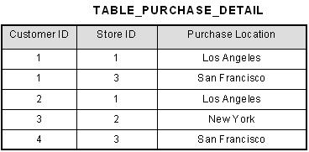
Functional Dependency A→B
An attribute B, has a functional dependency on another attribute A,
if : for any two records,
which have the same value for attribute A,
Should have same values for attribute B in these two records.
We represent this as:
A → B
Spoken as A determines B
StoreId-> PurchaseLocation
StoreID determines PurchaseLocation

Slide 6
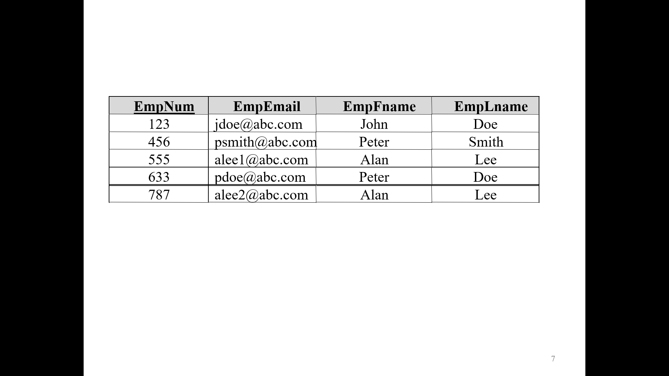
Functional Dependency A→B
A → B
Example:
In Employee table,
we have only one email address for each employee.
Each employee is identified by their unique employee number.
Then, there is a
functional dependency of email address
on employee number:
Employee_number → email_address

Slide 7
Functional Dependency A→B
EmpNum
EmpEmail
EmpFname
EmpLname
123
jdoe@abc.com
John
Doe
456
psmith@abc.com
Peter
Smith
555
alee1@abc.com
Alan
Lee
633
pdoe@abc.com
Peter
Doe
787
alee2@abc.com
Alan
Lee
If EmpNum is the PK then the FDs (Functional Dependencies):
EmpNum → EmpEmail
EmpNum → EmpFname
EmpNum → EmpLname
must exist.

Slide 8
2 different ways to depict FDs
Functional Dependency A→B
EmpNum → EmpEmail
EmpNum → EmpFname
EmpNum → EmpLname
EmpNum EmpEmail EmpFname EmpLname

Slide 9
Determinant
Functional Dependency A→B
Functional Dependency
EmpNum → EmpEmail
Attribute on the Left Hand Side is known as the determinant
EmpNum is a determinant of EmpEmail

Slide 10
Functional Dependency A→B
If,
one set of attributes(A) in a table
determines (→)
another set of attributes (B) in the table,
then
the second set of attributes(B) is said
to be functionally dependent
on the first set of attributes (A)
B is said to be functionally dependent on A

Slide 11
Exercise:
Consider Orders table
Find its Functional Dependencies

Slide 12

Transitive Dependency A→B →C
Consider attributes A, B and C where
A → B and B → C.
Functional dependencies are transitive,
Means we hence derive the functional dependency
(we can get)
A → C
C is transitively dependent on A through B.
via

Slide 13
Transitive Dependency A→B →C
EmpNum → DeptNum
EmpNum EmpEmail DeptNum DeptNname
DeptNum → DeptName
EmpNum EmpEmail DeptNum DeptNname
DeptName is transitively dependent on EmpNum via DeptNum
EmpNum → DeptNum
DeptNum → DeptName
EmpNum → DeptNum → DeptName
EmpNum → DeptName

Slide 14
Partial dependency (A1,A2), A2 →B
A partial dependency exists when
an attribute B is functionally dependent on an attribute A, and A is a part of candidate key.
OrderId
ProdId
ProdName
UnitPrice
Qty
Table: OrderDetails
Candidate key(A): {OrderID, ProdId}
Student activity: Write using A-> B notation
A= {OrderID, ProdId}
a) Find B
b) Are there any other A than {OrderID, ProdId}

Slide 15
Partial dependency (A1,A2), A2 →B
OrderId
ProdId
ProdName
UnitPrice
Qty
Candidate key: {OrderID, ProdId}
ProdID is a determinant of ProdName and Unitprice
ProdID-> ProdName, UnitPrice
BUT ProdId is part of a candidate key {OrderID, ProdId}
ProdName and UnitPrice is partially dependent on ProdId

Slide 16

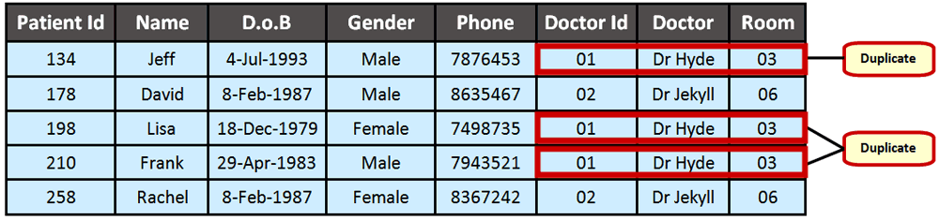
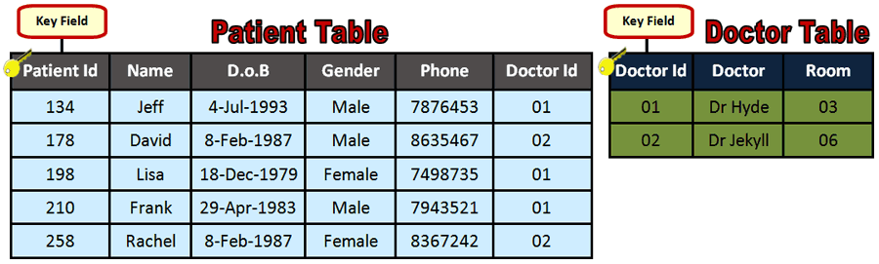
Normalization
Normalization is the process of efficiently organizing data in a database.
Goals of the normalization process:
Eliminating redundant data
(Ex,
storing the same data in more than one table) and
Ensuring data dependencies make sense
(only storing related data in a table).
These goals reduce the amount of space a database uses and ensure that data is logically stored.
Notes:
https://www.ictlounge.com/html/types_of_databases.htm

Slide 17
Normalization
This includes:
Creating new tables and
Establishing Relationships between those tables according to rules designed
by eliminating redundancy and inconsistent dependency.
Redundant data wastes disk space and creates maintenance problems.
If data that exists in more than one place must be changed, the data must be changed in exactly the same way in all places.
A customer address change is much easier to implement if that data is stored only in the Customers table and nowhere else in the database.

Slide 18
Normalization
The objective of normalization:
“to create relations where every dependency is on
the key,
the whole key, and
nothing but the key”.

Slide 19
NORMAL FORMS
1 NF-Key
2NF –Whole Key
3NF - nothing but the key

Slide 20
Normal Forms
There is a sequence to normal forms:
1NF is considered the weakest,
2NF is stronger than 1NF,
3NF is stronger than 2NF
Normal Form: 1NF 2NF 3NF
Strength :Weakest Stronger More Stronger

Slide 21
Normal Forms
1NF
Any relation in 3NF
is in
2NF;
2NF
3NF
and
Any relation in 2NF
is in
1NF.
BCNF

Slide 22
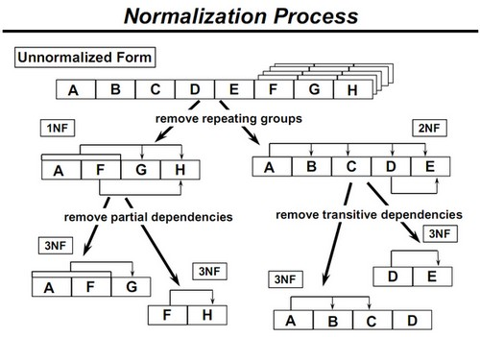
A table is in 1NF if there are no repeating groups in the table. A table is in 1NF if all non-key fields are functionally dependent on the PK. for each given value of PK, we always get only one value of the non-key field(s). We say a relation is in 1NF if all values stored in the relation are single-valued and atomic. Values must be simple.
Normal Forms
1 NF

Slide 23
Normal Forms
1 NF
EmpNum
Emp_DOB
EmpDegrees
123
233-9876
333
233-1231
BA, BSc, PhD
679
233-1231
BSc, MSc
The above table is in not in 1NF
EmpDegrees is a multi-valued field:
employee 679 has two degrees: BSc and MSc
employee 333 has three degrees: BA, BSc, PhD

Slide 24
Normal Forms
1 NF
EmpNum
EmpPhone
EmpDegrees
123
233-9876
333
233-1231
BA, BSc, PhD
679
233-1231
BSc, MSc
To obtain 1NF relations we must,
without loss of information,
replace the above
with two relations

Slide 25
Normal Forms
1 NF- Decomposition
Place all items that appear in the repeating group in a new table
2. Assign a primary key for each new table produced.
Duplicate in the new table the primary key of the table from which the
repeating group was extracted.
EMPNUM | EMP_DOB | EmpDegrees
123 | 23-MAY-1981
333 | 13-JAN-1989 | BA,BSC,PHD
679 | 5-FEB-200 | BSC, MSC
EmpDegree
BA
BSC
PHD
BSC
MSC
DEGID | EmpDegree
1 | BA
2 | BSC
3 | PHD
4 | BSC
5 | MSC
DEGID | EMPNUM | EmpDegree
1 | 333 | BA
2 | 333 | BSC
3 | 333 | PHD
4 | 679 | BSC
5 | 679 | MSC

Slide 26
Normal Forms
1 NF- Decomposition
EmployeeDegree
Employee
EmpNum
EmpDegree
EmpNum
EmpPhone
333
BA
123
233-9876
333
BSc
333
233-1231
333
PhD
679
233-1231
679
BSc
679
MSc
An outer join between Employee and EmployeeDegree will produce the information we saw before

Slide 27
Normal Forms
1 NF- Decomposition
Exercise:
Consider Customer table [CustID,Cname, Caddr, CPhone1,CPhone2] Check if it is in 1NF
If not then normalize it to 1NF

Slide 28
Suppose a company wants to store the names and contact details of its Customers. It creates a table that looks like this. Is it in 1 NF?
PersonId | P_name | P_address | P_mobile
101 | Herschel | New Delhi | 8912312390
102 | Jon | Kanpur | 8812121212, 9900012222
103 | Ron | Chennai | 7778881212
104 | Lester | Bangalore | 9990000123, 8123450987
Customer table is not in 1NF as it has multivalued attribute-P_mobile. So it decomposes into Customer and Customer_Contact table.

Slide 29
Customer and Customer_Contact table.
Normal Forms
1 NF- Decomposition Exercise:
PersonId | P_name | P_address
101 | Herschel | New Delhi
102 | Jon | Kanpur
103 | Ron | Chennai
104 | Lester | Bangalore
PID | PersonId | P_mobile
1 | 101 | 8912312390
2 | 102 | 8812121212
3 | 102 | 9900012222
4 | 103 | 7778881212
5 | 104 | 9990000123
6 | 104 | 8123450987

Slide 30
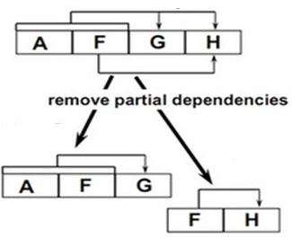
Partial dependency (A1,A2), A2 →B
Normal Forms
2 NF- Second Normal Form
A relation is in 2NF if it is in 1NF, and
Every non-key attribute is fully dependent on each candidate key.
(That is, we don’t have any partial functional dependency.)
A key attribute is any attribute that is part of a key;
Any attribute that is not a key attribute, is a non-key attribute.
A relation in 2NF will not have any partial dependencies

Slide 31
Normal Forms
2 NF
Consider OrderItem table:
OrderNo
ProdNo
ProdName
UnitPrice
Qty
There are two candidate keys.
OrderNo, ProdNo
ProdName, UnitPrice,Qty
ProdNo
ProdName, UnitPrice
OrderItem is not 2NF
since there is a partial dependency of
ProdName and Unitprice on ProdNo

Slide 32
Normal Forms
2 NF
OrderItem
OrderNo
ProdNo
ProdName
UnitPrice
Qty
Improve the db by decomposing the relation into two relations,
OrderItem and Products:
OrderNo
ProdNo
Qty
ProdNo
ProdName
UnitPrice

Slide 33
2NF - Decomposition
Place all items that appear in the repeating group in a new table
If a data item is fully functionally dependent on only a part of the PK,
move that data item and that part of the primary key to a new table.
2. Make the partial primary key copied from the original table as
the primary key for the new table.
OrderNo | ProdNo | ProdName | UnitPrice | QtyOrd
101 | P1 | Mango | 50 | 5
101 | P4 | Strawberries | 150 | 3
102 | P1 | Mango | 50 | 3
103 | P4 | Strawberries | 150 | 5
ProdNo | ProdName | UnitPrice
P1 | Mango | 50
P4 | Strawberries | 150
P2 | Banana | 20
OrderNo | ProdNo | QtyOrd
101 | P1 | 5
101 | P4 | 3
102 | P1 | 3
102 | P4 | 5
Notes:
If there is a table with columns A,B,C,D with Primary Key (A,B) & D is dependant on A (alone) then to be 2NF, you should reduce (split) tables as:
Table with columns A,D with Primary Key (A)
Table with columns A,B,C with Primary Key (A,B)

Slide 34
Transitive Dependency A→B →C
Normal Forms
3 NF- Third Normal Form
A relation is in 3NF
if the relation is in 2NF and
Does not have any transitive dependencies
of non-key attribute on a candidate key through
another non-key attribute.

Slide 35
Normal Forms
3 NF
Meet all the requirements of the second normal form.
Remove columns that are not dependent
upon the primary key.

Slide 36
Normal Forms
3 NF
Consider this Employee relation
Candidate keys are? …
EmpNum
EmpName
DeptNum
DeptName
Candidate key: EmpNum
Non-key attributes: EmpName, DeptNum, and DeptName.
DeptNum determines DeptName
BUT DeptNum is not a candidate key for Employee relation
Is the relation in 3NF? … no
Is the relation in 2NF? … yes

Slide 37
Normal Forms
3 NF
EmpNum
EmpName
DeptNum
DeptName
We correct the situation by decomposing the original relation into two 3NF relations: Employee and Department
EmpNum
EmpName
DeptNum
DeptNum
DeptName
Now both relations EMP and Department are in 3NF.

Slide 38
Transitive Dependency A→B →C
Normal Forms
3 NF
P_id | P_name | p_zip | p_state | p_city | p_district
1001 | John | 282007 | TN | Chennai | Dayal Bagh
1002 | Ajeet | 222008 | TN | Chennai | M-City
1006 | Lora | 282007 | TN | Chennai | Dayal Bagh
1101 | Lilly | 292008 | UK | Pauri | Bhagwan
1201 | Steve | 222999 | MP | Gwalior | Ratan

Slide 39
Customer table is not in 3NF as it has transitive dependency- P_id->p_zip and p_zip->{p_city,p_district,p_state} So it decomposes into Customer and Customer_Address table
Normal Forms
3 NF
P_id | P_name | p_zip
1001 | John | 282007
1002 | Ajeet | 222008
1006 | Lora | 282007
1101 | Lilly | 292008
1201 | Steve | 222999
p_zip | p_state | p_city | p_district
282007 | TN | Chennai | Dayal Bagh
222008 | TN | Chennai | M-City
292008 | UK | Pauri | Bhagwan
222999 | MP | Gwalior | Ratan

Slide 40
Normal Forms Summary
First Normal Form
No repeating groups in tables
Second Normal Form
Table is 1st normal form and no partial key dependencies
Third Normal Form
Table is in 2nd normal form and has no transitive dependencies

Slide 41
Interested in More examples
Then you are welcome
to investigate further

Slide 42
Exercise:
Consider Orders table [
OrderID, OrderDate, CustID,
ProdID, Prodname, UnitPrice,
Qty, TotalPrice
ProdID, Prodname, UnitPrice,
Qty, TotalPrice
] Check if it is in 1NF
If not then normalize it to 1NF

Slide 43
Is the below Order table in 1 NF?
OrderNo | Order Date | CustNo | Prod_Id | Prod_ Name | Quantity-KGs | Unit_price | Bill_amount | Prod_Id | Prod_Name | Quantity-KGs | Unit_price | Bill_amount
1 | 17-Oct-17 | C1 | P1 | Mango | 1 | 40 | 40 | P2 | Apples | 5 | 50 | 250
2 | 19-Oct-17 | C2 | P1 | Mango | 2 | 40 | 80 | P3 | Guava | 1 | 60 | 60
3 | 21-Oct-17 | C3 | P2 | Apples | 2 | 50 | 100
4 | 23-Oct-17 | C1 | P3 | Guava | 5 | 60 | 300
Order table is not in 1NF as it has repeating group .
the data for Prod_Id, Prod_Name, Unit_Price …..
is repeating. So it decomposes into Order and Order_Line table
Notes:
No. We get 2 rows for one order no. Also the data Orderno, Orderdate, customer no is repeating

Slide 44
Is the below Order table in 1 NF?
OrderNo | OrderDate | CustNo | Prod_Id | Prod_Name | Quantity-KGs | Unit_price | Bill_amount
1 | 17-Oct-17 | C1 | P1 | Mango | 1 | 40 | 40
1 | 17-Oct-17 | C1 | P2 | Apples | 5 | 50 | 250
2 | 19-Oct-17 | C2 | P1 | Mango | 2 | 40 | 80
2 | 19-Oct-17 | C2 | P3 | Guava | 1 | 60 | 60
3 | 21-Oct-17 | C3 | P2 | Apples | 2 | 50 | 100
4 | 23-Oct-17 | C1 | P3 | Guava | 5 | 60 | 300
Order table is not in 1NF as it has repeating group .
the data for Orderno, Orderdate, customer no is repeating. So it decomposes into Order and Order_Line table
Notes:
No. We get 2 rows for one order no. Also the data Orderno, Orderdate, customer no is repeating

Slide 45
Now, Order table is in 1 NF as its all cells have atomic and single value.
Order
OrderNo | OrderDate | CustNo
1 | 17-Oct-17 | C1
2 | 19-Oct-17 | C2
3 | 21-Oct-17 | C3
4 | 23-Oct-17 | C1
Order_line, Primary Key[Composite Key]= OrderNo +Prod_Id
 | OrderNo | Prod_Id | Prod_Name | Quantity-KGs | Unit_price | Bill_amount
 | 1 | P1 | Mango | 1 | 40 | 40
 | 1 | P2 | Apples | 5 | 50 | 250
 | 2 | P1 | Mango | 2 | 40 | 80
 | 2 | P3 | Guava | 1 | 60 | 60
 | 3 | P2 | Apples | 2 | 50 | 100
 | 4 | P3 | Guava | 5 | 60 | 300
What about Order_Line table. Is it in 1NF?

Slide 46
Is it in 2 NF?
Order
OrderNo | OrderDate | CustNo
1 | 17-Oct-17 | C1
2 | 19-Oct-17 | C2
3 | 21-Oct-17 | C3
4 | 23-Oct-17 | C1
Order_line Primary Key[Composite Key]= OrderNo +Prod_Id
 | OrderNo | Prod_Id | Prod_Name | Quantity-KGs | Unit_price | Bill_amount
 | 1 | P1 | Mango | 1 | 40 | 40
 | 1 | P2 | Apples | 5 | 50 | 250
 | 2 | P1 | Mango | 2 | 40 | 80
 | 2 | P3 | Guava | 1 | 60 | 60
 | 3 | P2 | Apples | 2 | 50 | 100
 | 4 | P3 | Guava | 5 | 60 | 300
Notes:
No, coz we can get Prod_name from part of the candidate key(prod_id). Same for Unit_Price

Slide 47
Second NF
Order_line
 | OrderNo | Prod_Id | Quantity-KGs | Bill_amount
 | 1 | P1 | 1 | 40
 | 1 | P2 | 5 | 250
 | 2 | P1 | 2 | 80
 | 2 | P3 | 1 | 60
 | 3 | P2 | 2 | 100
 | 4 | P3 | 5 | 300
PRODUCTS
Prod_Id | Prod_Name | Unit_price
P1 | Mango | 40
P2 | Apples | 50
P3 | Guava | 60

Slide 48
Is it in 3 NF
Order_line
 | OrderNo | Prod_Id | Quantity-KGs | Bill_amount
 | 1 | P1 | 1 | 40
 | 1 | P2 | 5 | 250
 | 2 | P1 | 2 | 80
 | 2 | P3 | 1 | 60
 | 3 | P2 | 2 | 100
 | 4 | P3 | 5 | 300
Prod_Id | Prod_Name | Unit_price
P1 | Mango | 40
P2 | Apples | 50
P3 | Guava | 60
Notes:
No cz Order_Line table, Bill_amount can be calculated by a column (Unit_Price) from other table Product

Slide 49
3 NF
Order_line
 | OrderNo | Prod_Id | Quantity-KGs
 | 1 | P1 | 1
 | 1 | P2 | 5
 | 2 | P1 | 2
 | 2 | P3 | 1
 | 3 | P2 | 2
 | 4 | P3 | 5
Notes:
No cz Order_Line table, Bill_amount can be calculated by a column (Unit_Price) from other table Product

Slide 51
First Normal Form
Remove the repeating groups and concatenate keys
so that the original table can be recovered by joining tables
ORD
ORD_NBR
ORD_DTE
CUS_NBR
CUS_NME
STR_ADR
CTY_ADR
STT_ADR
ZIP_ADR
TOT_AMT
.
.
.
ORD_ITM
ORD_NBR
ITM_NBR
ITM_DSC
ORD_ITM_PRICE
ORD_QTY
AMOUNT

Slide 52
Second Normal Form
Are these tables in 2nd NF?
In other words, are there any partial dependencies?
ORD
ORD_NBR
ORD_DTE
CUS_NBR
CUS_NME
STR_ADR
CTY_ADR
STT_ADR
ZIP_ADR
TOT_AMT
.
.
.
ORD_ITM
ORD_NBR
ITM_NBR
ITM_DSC
ORD_ITM_PRICE
ORD_QTY
AMOUNT

Slide 53
Second Normal Form
Remove any partial dependencies
Are there any transitive dependencies?
ORD
ORD_NBR
ORD_DTE
CUS_NBR
CUS_NME
STR_ADR
CTY_ADR
STT_ADR
ZIP_ADR
TOT_AMT
ORD_ITM
ORD_NBR
ITM_NBR
ORD_QTY
AMOUNT
ITM
ITM_NBR
ITM_DSC
ORD_ITM_PRICE

Slide 54
Third Normal Form
Remove transitive dependencies
ORD
ORD_NBR
ORD_DTE
CUS_NBR
TOT_AMT
CUS
CUS_NBR
CUS_NME
STR_ADR
CTY_ADR
STT_ADR
ZIP_ADR
ORD_ITM
ORD_NBR
ITM_NBR
ORD_QTY
AMOUNT
ITM
ITM_NBR
ITM_DSC
ORD_ITM_PRICE

Slide 55
Third Normal Form
Remove transitive dependencies
ORD
ORD_NBR
ORD_DTE
CUS_NBR
TOT_AMT
CUS
CUS_NBR
CUS_NME
STR_ADR
ZIP_ADR
ZIP
ZIP
CITY
STATE
ORD_ITM
ORD_NBR
ITM_NBR
ORD_QTY
AMOUNT
ITM
ITM_NBR
ITM_DSC
ORD_ITM_PRICE

Slide 56
DISCUSSION
Is the table Ord_Itm in 3NF?
How about the table ORD?

Slide 57
DISCUSSION
Is the table Ord_Itm in 3NF? No.
The Amount can be calculated by
multiplying Ord_Qty and ORD_ITM_PRICE
ITM_NMBR->ORD_ITM_PRICE-> Amount
How about the table ORD? NO.
there is functional dependence between the non-key attributes Tot_Amt and (Ord_Qty and ORD_ITM_PRICE)
(ORD_NMBR,ORD->
SUM[ (Ord_Qty ,ORD_ITM)*(ORD_ITM_PRICE,ITM)]

Slide 58
DERIVABLE DATA
Rule of thumb: Do NOT include derivable (computable) data in the baseline Logical database design schema
You may, selectively include some derivable data in your design, mainly to enhance the performance of your application – which, however, is a physical database design issue

Slide 59
Third Normal Form
Remove transitive dependencies
ORD
ORD_NBR
ORD_DTE
CUS_NBR
Tot_Bill
CUS
CUS_NBR
CUS_NME
STR_ADR
ZIP_ADR
ZIP
ZIP
CITY
STATE
ORD_ITM
ORD_NBR
ITM_NBR
ORD_QTY
AMOUNT
Derivable Fields
=
ITM
ITM_NBR
ITM_DSC
ORD_ITM_PRICE

Slide 60
QUESTION
Should an ERD be normalized for Relational database design purposes?

Slide 61
DISCUSSION
Non-normalized ERD
User-oriented
Good for capturing/communicating the semantics of the database application
Normalized ERD
Implementation-oriented
Can be used to directly define the database structure

Slide 62
References
https://www.thoughtco.com/database-normalization-basics-1019735
https://support.microsoft.com/en-us/help/283878/description-of-the-database-normalization-basics

Slide 63
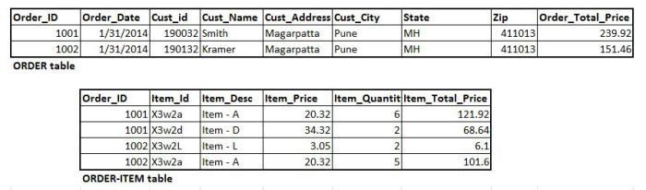
https://dwbilounge.wordpress.com/2015/01/06/looking-back-normalization/

